Slide 1
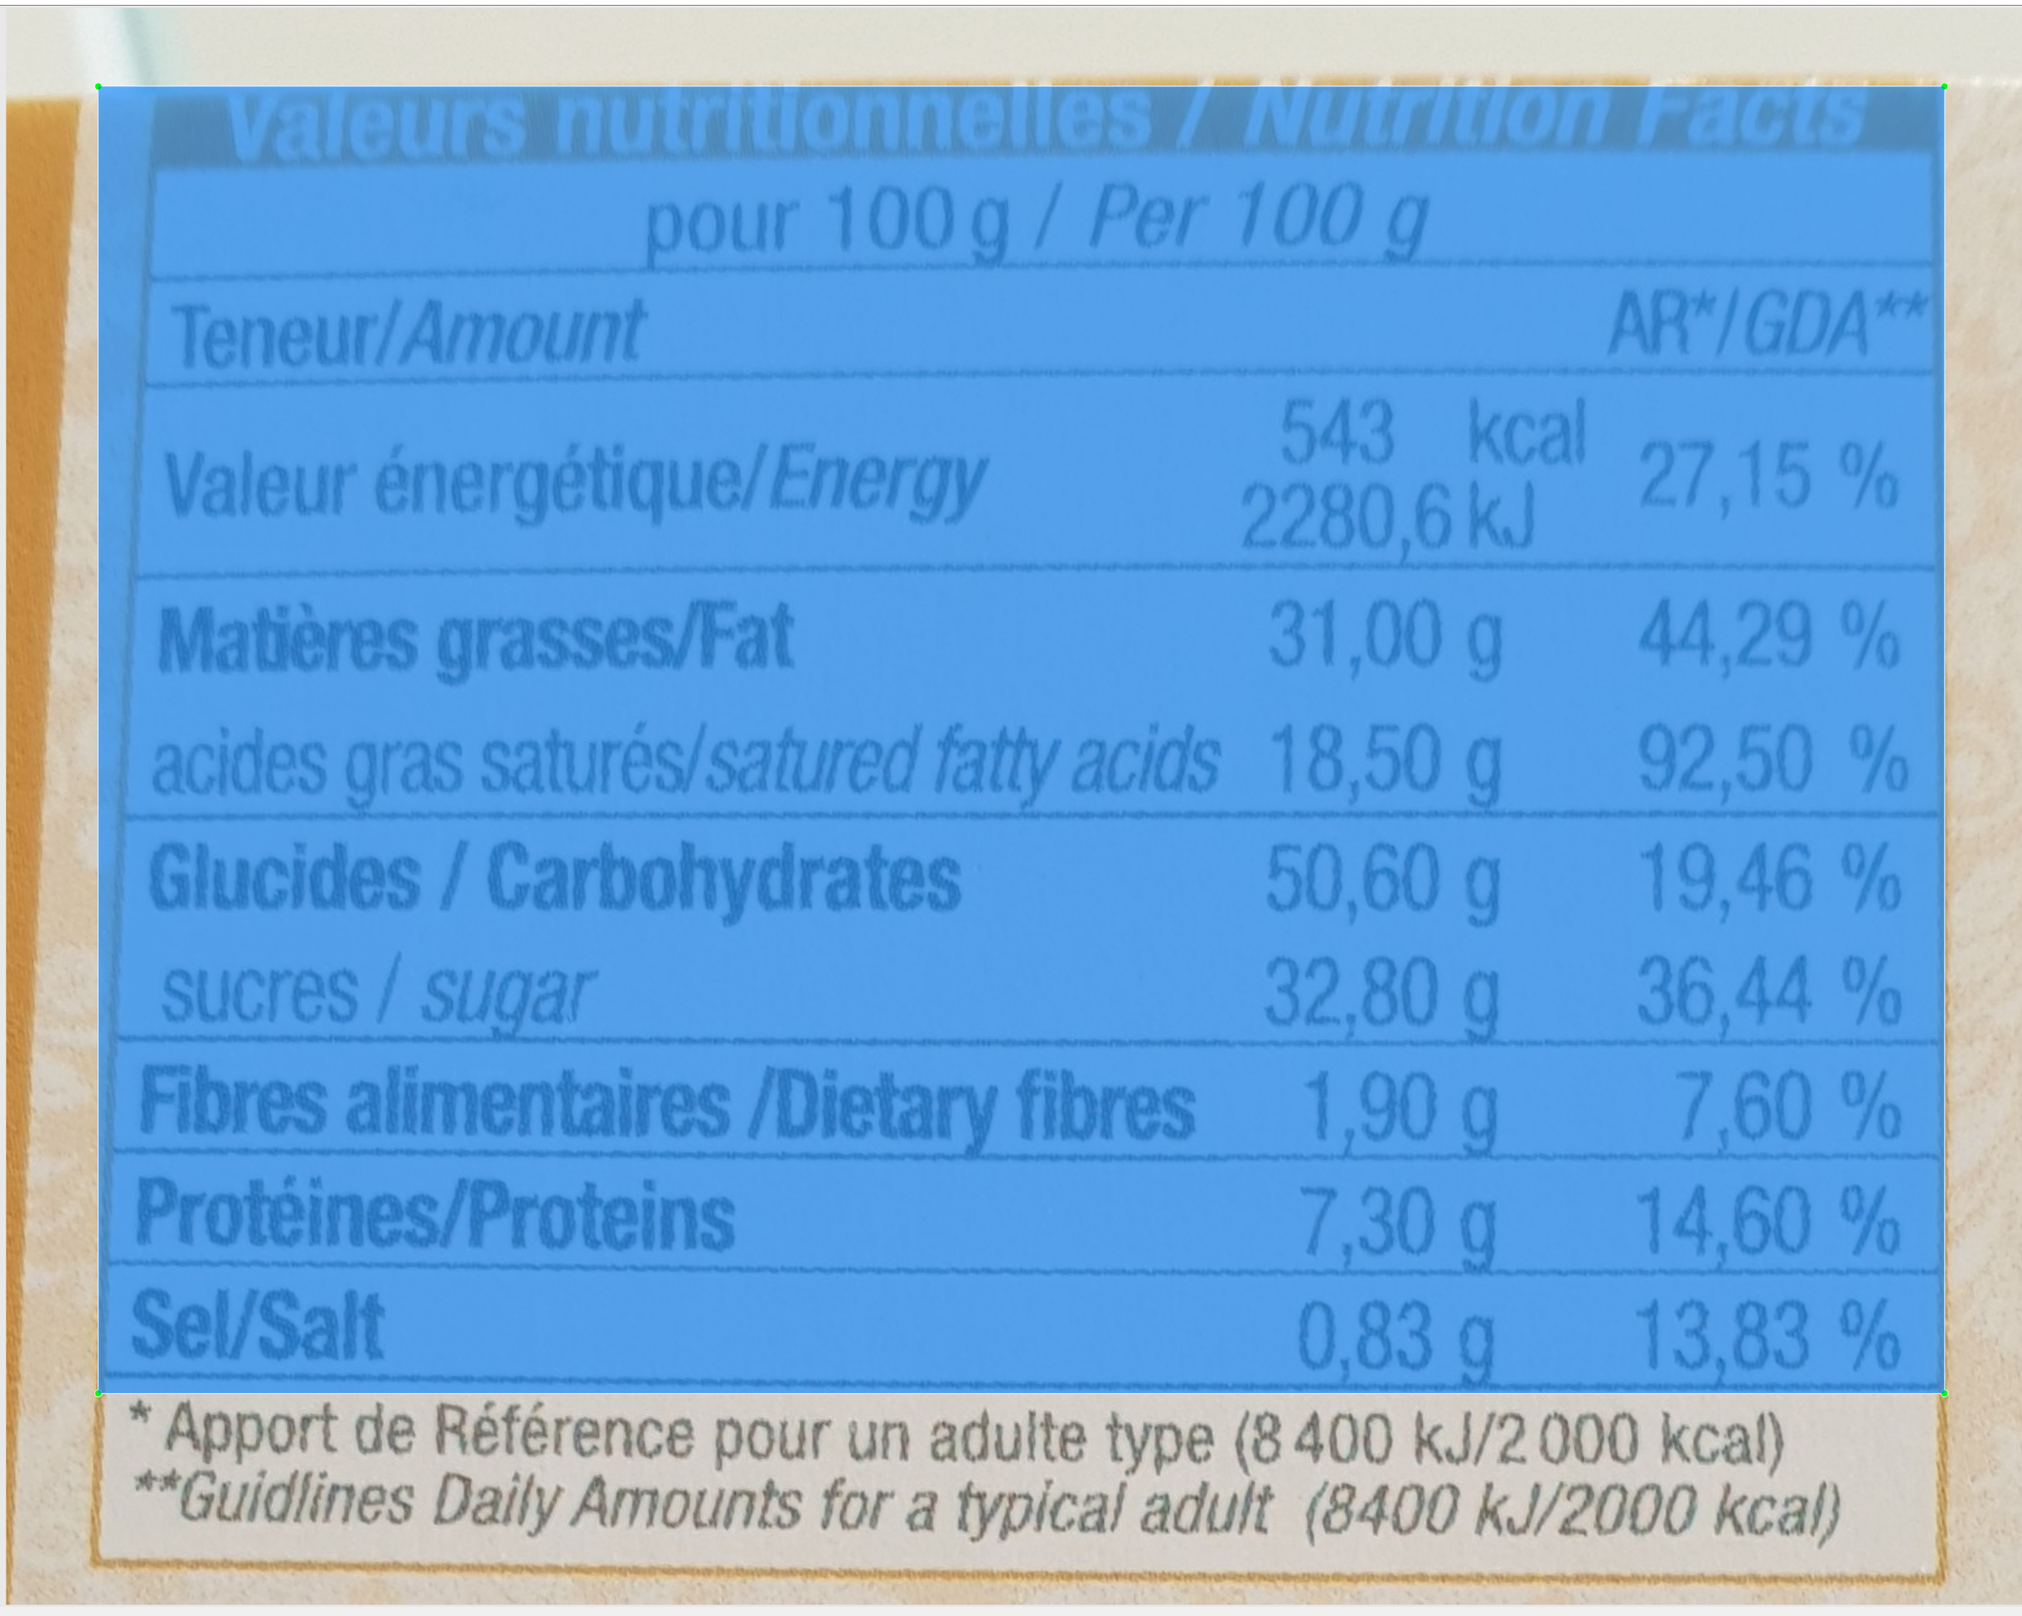
Annotate table before columns
Don’t include footer

Slide 2
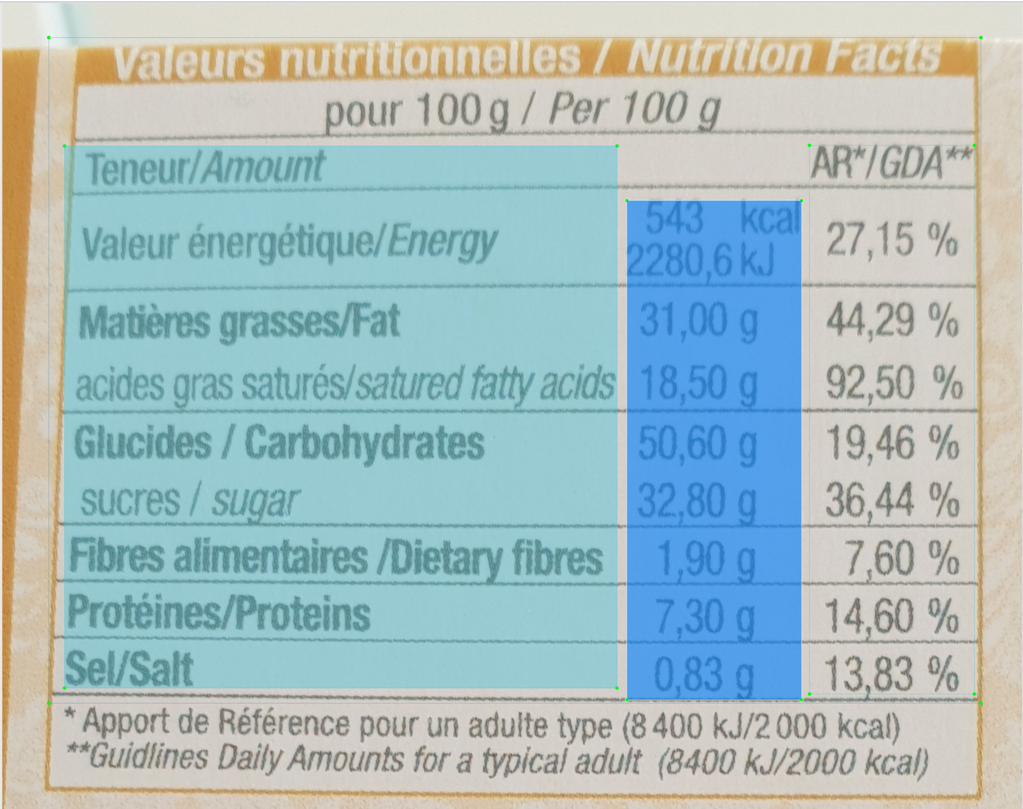
Don’t include merged cells in columns
Make sure the is a space between columns (No overlapping)
Annotate columns before lines (if applicable)
Limit the column size to the space taken by the text in the column only.

Slide 3
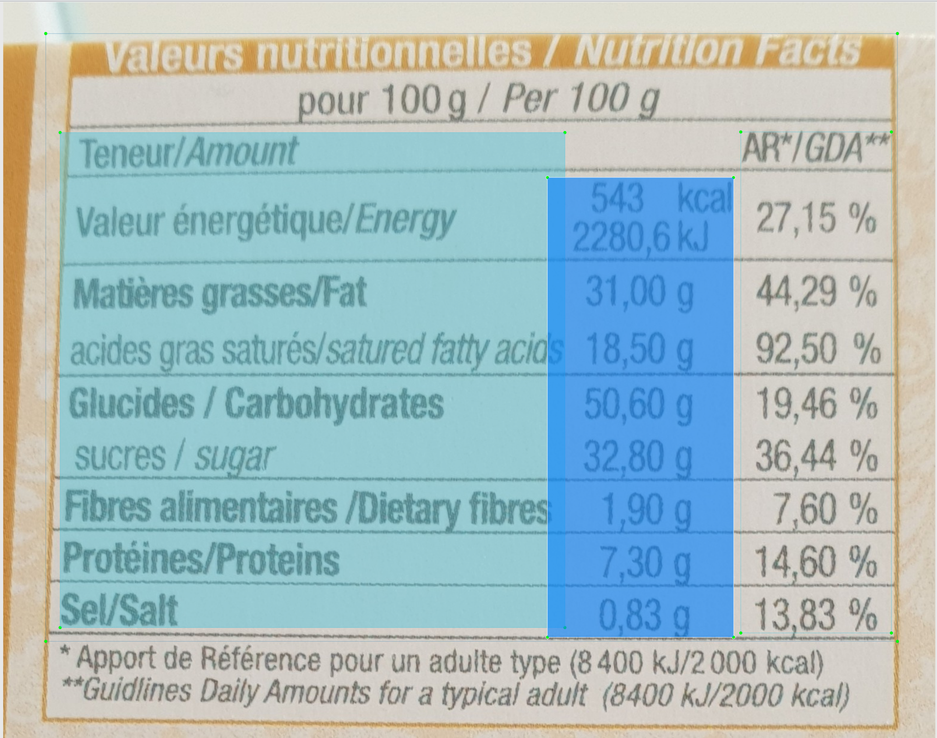
Overlapping. This is not a valid annotation.

Slide 4
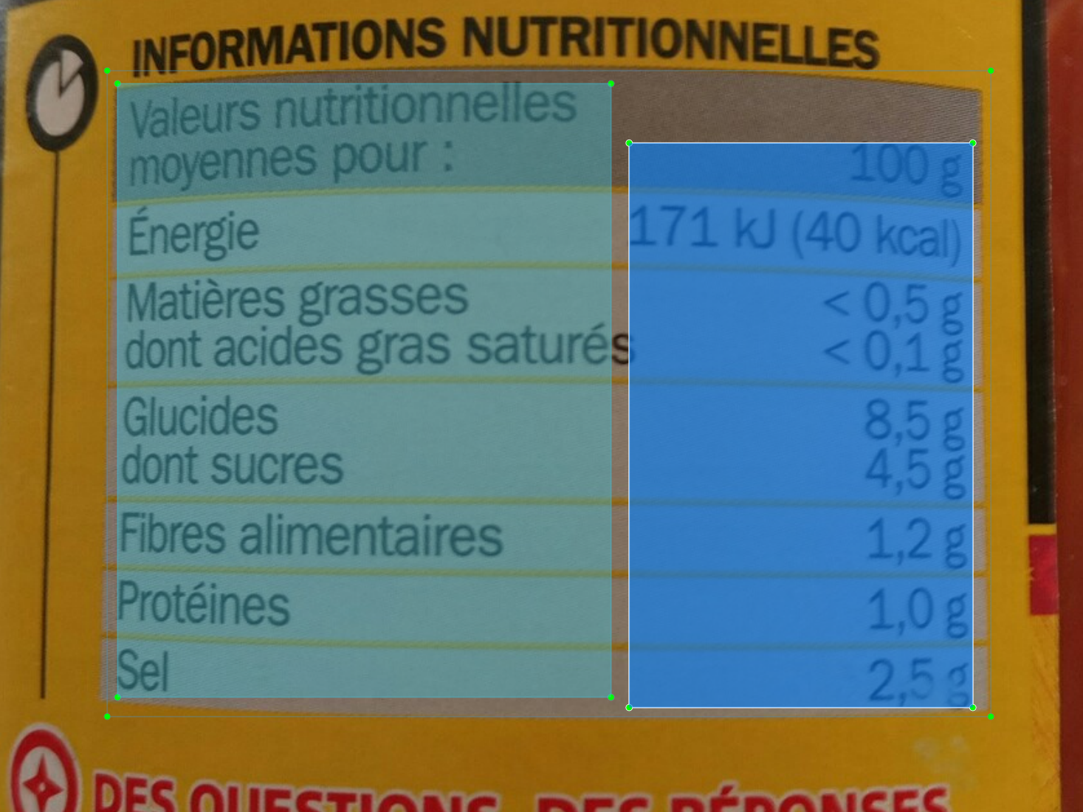
If small overlap between two columns
Make sure all numeric values are in one column. You can penalize textual column. In this example, shrink the string column to leave space between the two columns.

Slide 5
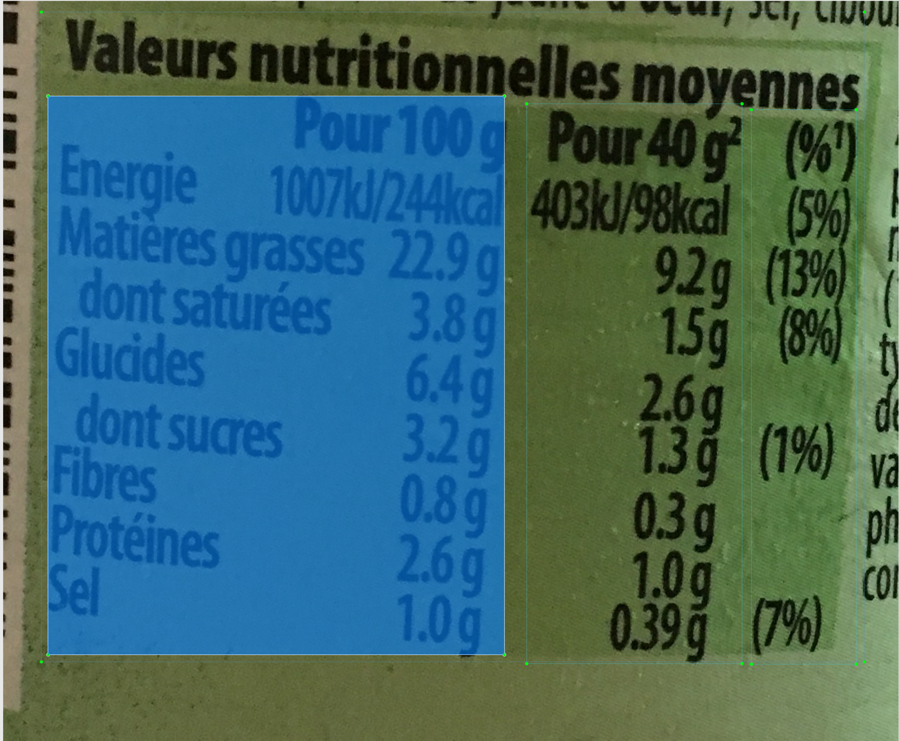
If big overlap between two columns
If the overlap is too important => Annotate both as one column.

Slide 6
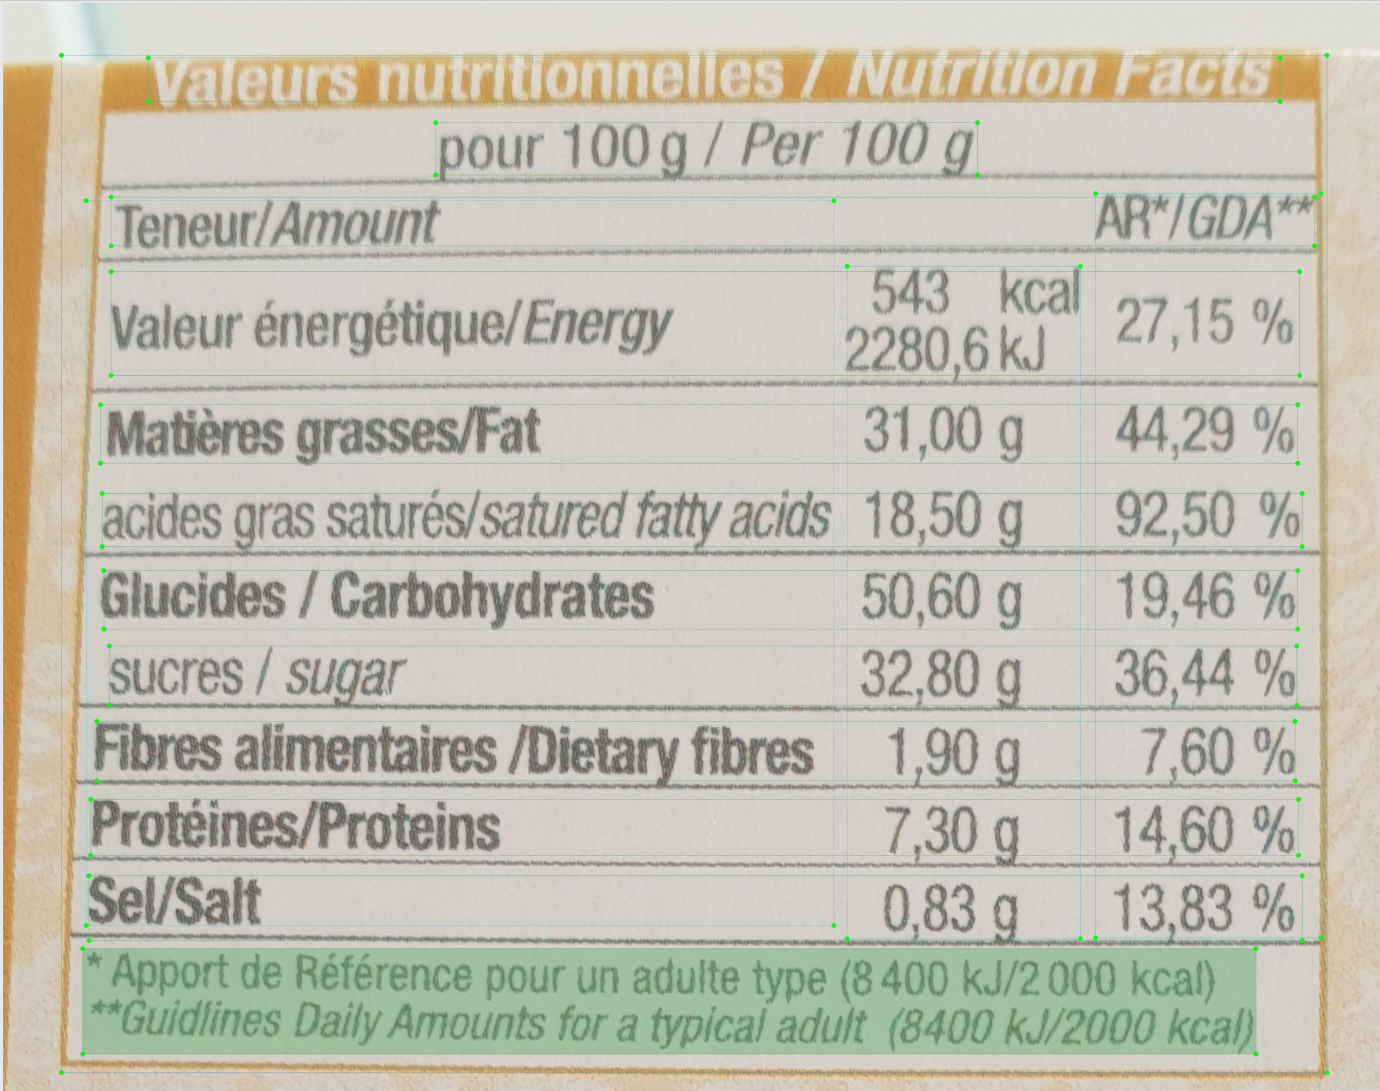
Line annotations will be done on table detected by first model (Table + Column detected)
In this case, only annotate lines when:
Only the table is shown on the picture (no additional text, paragraphs around)
The table is flattened (not cylindric) and not tilted to the right or left => Minum risk of annotation overlapping
Reminder: Overlapping boxes = Bad annotation

